Slide 1
Startup webhosting CIS1402 Power Point Presentation By: Andrew Seabloom
Modified presentation from CIS1410

Slide 2
Table of Contents
2
Intro to Webhosting For Students | 3 | Content Management System | 9
What Is a Domain | 4.0 | Webhosting Control Panel | 10
Types Of Webhosting Servers | 4.5 | Hacking and security | 11
Shared | 6 | Cloud | 7
Virtual | 8 | Dedicated | 9

Slide 3
3 Webhosting for students https://webhostingforstudents.com
Taught us
How to setup a domain name and hosting account
How to configure and use FTP, SFTP and SSH
How to configure email accounts
How to setup MySQL databases
How to install a Content Management System
Best practices for hosting security

Slide 4
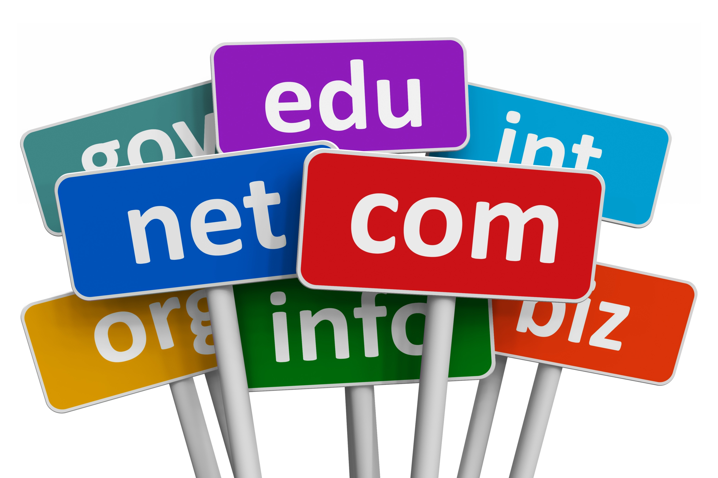
4 What is a domain name?
Types of Web Hosting Servers
A domain name is a unique web address that can be acquired through domain registration. Usually, domain names consist of a website name and a domain name extension. A good domain strengthens your branding and helps your audience find your website. Domain names are essentially your sites street address for on the web.
When you have a hosting account it gives you the ability to access webhosting servers to upload and manage files on your domain. There are four main types of hosting servers available.
Shared | Cloud
Virtual | Dedicated
4.5

Slide 5
5 Shared
The most common hosting plan. Shared hosting means resources like CPU, time, memory and space with other websites on the same server will all be shared.
Pros
Very affordable
Easy to setup and operate
Cons
No control over performance
Only useful for small websites

Slide 6
6 Cloud
Cloud hosting is the exact same resources as with a shared hosting machine. Only the hosting machine is all virtual hardware. It is very advanced and rather cost effective.
Pros
Scalable and efficient
Pay only for what you use
Cons
Requires advanced IT knowledge
Potentially insecure

Slide 7
7 Virtual
Allot like shared hosting only you are solely responsible for performance and maintenance. It is not very popular and prices will vary.
Pros
More powerful then shared hosting
Other websites will not affect your own
Cons
Private space is more expensive
Requires allot of IT knowledge

Slide 8
8 Dedicated
Your own hosting server, All resources belong to you, no shared time or memory. You have the only account on the server
Pros
Full control over your server
Best performance and availability for any hosting server
Cons
Most expensive hosting server
Extensive IT knowledge is required

Slide 9
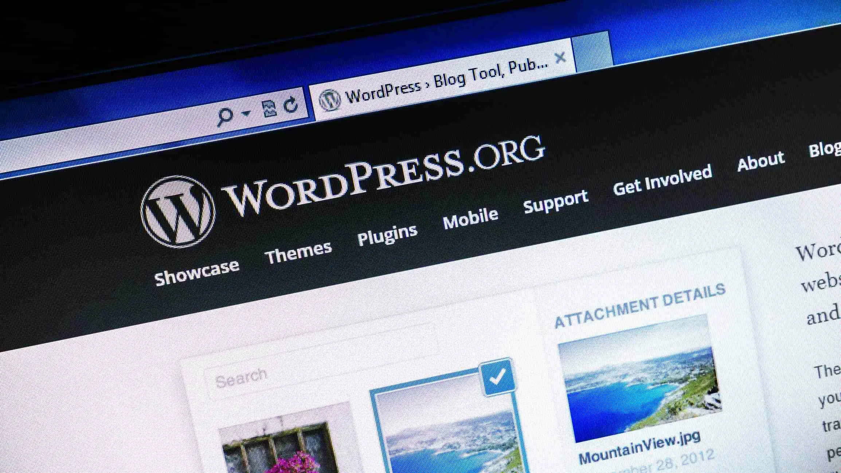
9 Content Management systems (cms)
A content management system is software or a set of related programs that are used to simplify the process of creating and managing digital content.
A CMS is typically used for Enterprise Content Management (ECM) and Web Content Management (WCM)
An ECM facilitates collaboration in the workplace by integrating document management, digital asset management, and records retention functionalities.
Also provides the end users with role-based access to the organization’s digital assets.
A piece of software like WordPress, that lets the user easily add and edit content on a site without using a code.
A CMS typically uses a database to store content behind the scenes

Slide 10
10 Web hosting Control panel
A control panel is the tool that allows the user to access software like WordPess, manage files, setup linked email accounts, and add additional domain names. Cpanel is an industry standard.

Slide 11
11 Hacking and security
The majority of website breaches are not to try and steal your data or deface your website. Instead, they attempt to use our server as an email relay for spam. Or to setup a temporary web server to serve files of an illegal nature.
Google quarantines about 10000 websites per day with its safe browsing technology.
Sites get hacked by:
Brute force, hackers attempt to match or break the login code
Social Engineering, Phishing pages designed to capture a person’s username and password
Cross Site Scripting, the attacker tries to intercept the user credentials via their own browser
Man In The Middle Attack, Attackers incepts user credentials while working via an unsecure network. Credentials are transferred from one point to another via plain text
Identifying and then exploiting the weakness in a computer system.
Hackers usually are skilled computer programmers with knowledge of computing security.

