Slide 1
Module 1
Some of the things I found most interesting.
By Andrew Seabloom

Slide 2
Table of contents
What is the Internet 3
Communication Protocols 5
Popular Scripting Languages 7
WordPress 9
Domain Names and what they stand for 4
Categories Of Websites 6
Content Management System 8

Slide 3
What is the Internet
The internet is a collection of millions of computers all linked together on one unified network. Its That same collection of computers that host the web which is the internet-based information system.
Image from https://informationq.com/wp-content/uploads/2016/10/Internet.jpg

Slide 4
Domain Names and what they stand for
The domain name is how we identify what type group the site belongs to and then it grants the user access to that server.
.aero Air Transport Industry
.biz Business
.com Commercial
.coop Cooperatives
.edu Educational
.gov Governemental
.info Informational
.mil U.S. Military
.name Individuals by name
.net Network
.org Organization
.pro Professionals
https://www.domainsherpa.com/

Slide 5
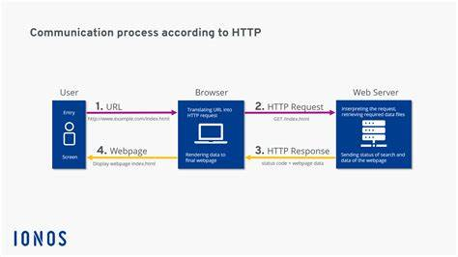
Communications Protocols
HTTP and TCP/IP, are both communications protocols that determine how information is transferred between computers. TCP manages the data stream and HTTP describes what the data in the stream contains
https://th.bing.com/th/id/R.e3e481dd837a8842da0c82109bef6731?rik=ZrM3qdxsnVKN0w&riu=http%3a%2f%2fwww.thaqafnafsak.com%2fwp-content%2fuploads%2fhow_tcp-ip_works_.jpg&ehk=auJtWO2w0ijoq5ES0AE5Mrk8TJVhSSHHGLKTilrP03o%3d&risl=&pid=ImgRaw&r=0
https://www.ionos.ca/digitalguide/fileadmin/DigitalGuide/Screenshots_2020/diagram-of-http-communication-process.png

Slide 6
Categories Of Websites
There Are 4 main categories of websites:
Personal websites such as a Social Media (Facebook, Linkedin) and or any sort of personal website.
Topical websites Are websites that post about specific topics. Some relating to products, some world events and other news.
Organizational websites Nonprofit groups often fall into the organization category. The salvation army is an example.
Commercial websites, any .com qualifies as a commercial website. Usually selling products and/or services.

Slide 7
Popular Scripting Languages
According to Indeed.com: Javascript, PHP, Python, Perl, and Ruby are 5 of the most popular scripting languages.
Javascript is an interpreted programming language that conforms to the ECMAScript specification
PHP distinguishes from client-side JavaScript, the code is executed on the server, generating HTML which is then sent to the client. The client would receive the results of running that script, but would not know what the underlying code was. You can even configure your web server to process all your HTML files with PHP
Python is a well-known high-level programming language. The Python script is basically a file containing code written in Python
Perl is a high-level interpreted and dynamic programming language that may be used for a variety of tasks. It is also a scripting language that is pretty simple and well-respected. It may be used for a number of purposes, but it is most used in Web development to construct CGI scripts.
Ruby is a scripting language designed for front-end and back-end web development. It’s also very user-friendly compared to other programming languages.

Slide 8
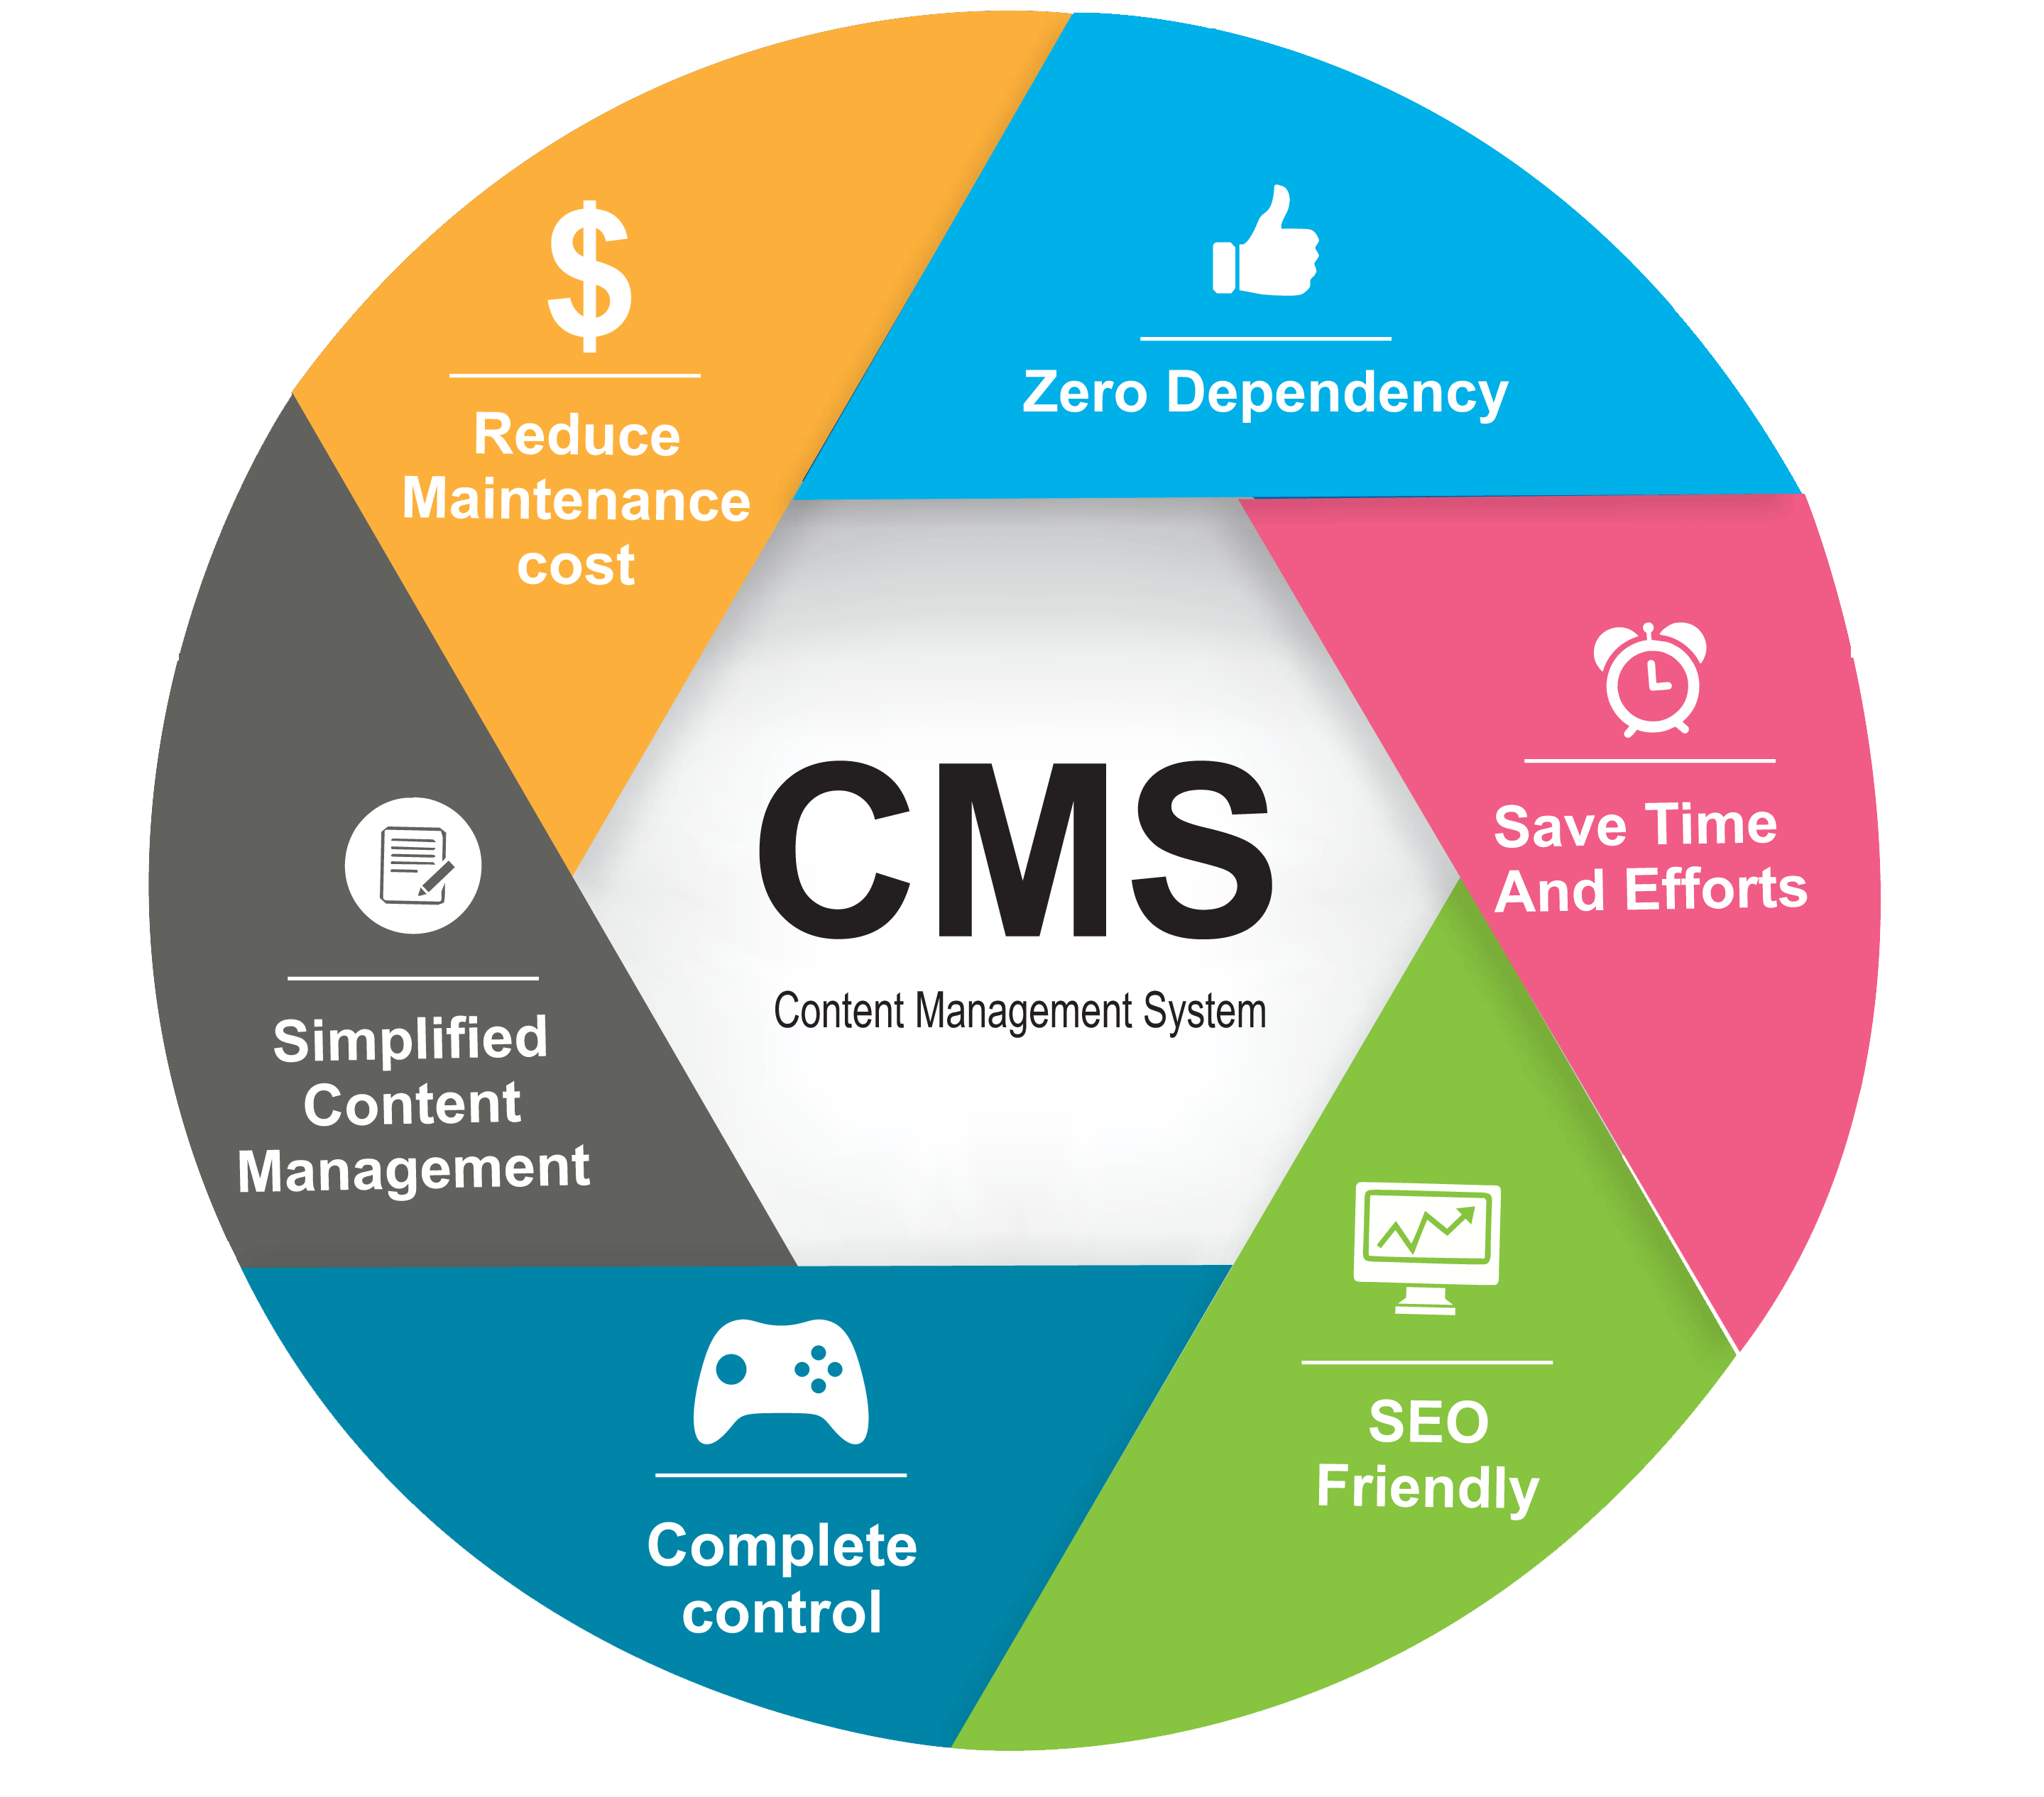
Content Management System
The Content Management System (CMS), Is computer software used to manage the creation and modification of digital content.
A CMS typically has two major components: a content management application (CMA), as the front-end user interface that allows a user, even with limited expertise, to add, modify, and remove content from a website. Also a content delivery application (CDA), that compiles the content and updates the website.
There are two types of CMS installation: on-premises and cloud-based. On-premises installation means that the CMS software can be installed on the server. The cloud-based CMS is hosted on the vendor environment.

Slide 9
WordPress
WordPress a website builder CMS that’s simple to set up, easy to customize, and easy to use.
WordPress is also one of the most popular Content Management Systems.
WordPress has thousands of plugins readily accessible to upload and integrate into a designer/WordPress user’s website.
https://th.bing.com/th/id/R.e66b76e137f759fd68d00050aca72dd5?rik=0%2biQqYWO0I%2b1rw&pid=ImgRaw&r=0

